Slide 1
INTRODUCTION TO SOCIETY, EQUITY & SUSTAINABILITY

Slide 2
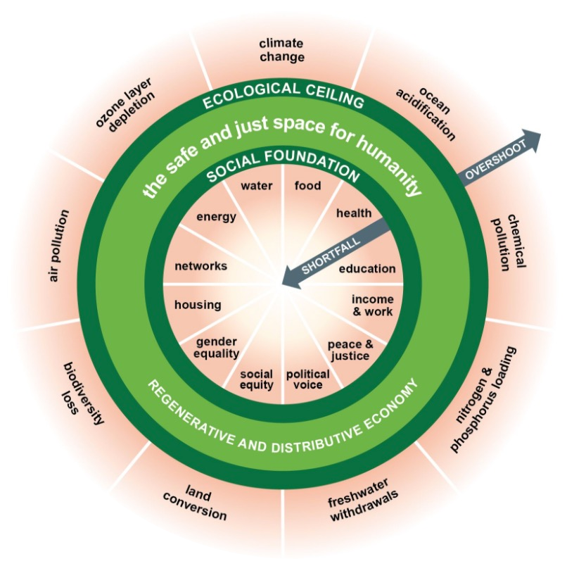
The OXFAM DOUGHNUT
What do you see here that you would expect to see on a sustainability diagram?
What are you surprised to see included in this sustainability diagram?
Watch the Oxfam video by double clicking the next slide.
Website: http://www.kateraworth.com/doughnut/
Notes:
Introduce this diagram to the class as one depiction of sustainability, from Oxfam, a global NGO (non-governmental organization) focused on ending poverty. Give the students a minute or so to look at the diagram, and then facilitate an initial conversation among the students to allow them to interpret the diagram for themselves – to lay out their initial understanding of the relationship between societal and environmental issues. Facilitate discussion around the questions listed above. Note that to the first question, students usually talk about environment-related issues, notably those in the outer ring, “ecological ceiling,” and in the inner ring, energy, water, and food. To the second question, students often bring up gender equality, voice, and social equity. If these issues are not brought up, bring their attention to them and ask why they think they’re included here and what the diagram seems to be trying to say.

Slide 3
Video: Kate Raworth (Oxfam)
“Introducing ‘The Doughnut’: A Safe and
Just Space for Humanity”
Notes:
Next, show this 4-min. video by the diagram’s creator, Kate Raworth of Oxfam: Introducing 'The Doughnut': A safe and just space for humanity The next slide provides useful discussion questions about the diagram, which will surface students’ deeper understanding. Note: This video uses an older version of the doughnut graphic.

Slide 4
Post-video discussion
What stood out to you about the relationship between the social foundations and the environmental ceiling (now called the ecological ceiling in the updated diagram)?
How does the Oxfam Doughnut challenge us to think in new ways about sustainability?
How does it challenge us to think in new ways about the economy?
What does it suggest are the responsibilities of the ‘developed’ world, and countries like the U.S., in creating a sustainable world?
What questions does this bring up for you?

Slide 5
Sustainability and Equity
In sum – the Oxfam Donut demonstrates that we cannot have a sustainable world unless we also attend to the concept of EQUITY:
“Ensuring all people’s lives are built upon a social foundation is essential for sustainable development, but so is staying below the environmental ceiling: crossing over either of these boundaries can trigger both social and ecological crises. Sustainable development can only succeed if poverty eradication and environmental sustainability are pursued together.”
- Kate Raworth, “A Safe and Just Space for Humanity: Can We Live Within the Doughnut?,” p.8
Notes:
Conclude your discussion of the Oxfam Donut by emphasizing the key point: that addressing issues related to social equity is key to achieving a sustainable world.
Next, ask students what they think the word “Equity” means.

Slide 6
What Do we mean by “Equity?”
While there is no single, universally accepted definition of equity, one good candidate is an absence of disparities that are systematically associated with social advantage/disadvantage (adapted from Paula Braveman, “Defining Equity in Health”).
A student VIP (Vertically Integrated Project) team at Georgia Tech studying equity in relation to the sustainable built environment looked at multiple definitions and then created their own: “Equity is just and fair inclusion that is created and sustained through access to opportunities, networks, resources, and support, paying special attention to traditionally underrepresented populations."
King County, WA is well-known for its work on equity as a key piece of sustainable development. It breaks equity into three pieces:
Distributional equity – fair and just distribution of benefits and burdens
Process equity – inclusive, open and fair access by all stakeholders to decision processes
Cross-generational equity – fair and just distribution of benefits and burdens to future generations
Notes:
Stress these are starting points
Follow King County link for more detailed explanations of each part of equity
Ask students how they see equity as similar to or different from equality?

Slide 7
Equity is not Equality
It is important to differentiate equity from equality:
When a system is rooted in equality, all people, from all segments of society, are given the same opportunities and the same levels of support.
In contrast, a system rooted in equity goes a step further and offers different levels of support depending upon need, to achieve greater fairness of outcomes.

Slide 8
Equity is not Equality: BUS EXAMPLE
Equality gives everyone the right to ride on the bus, in any seat they choose. Equity ensures there are bus lines where people need them so they can get to school or the doctor or work. It means policies and investments that grow good jobs and expand entrepreneurship opportunities for low-income people and people of color. It means policies that build human capabilities by upgrading the education and skill of the nation’s diverse workforce. It means policies that dismantle destructive barriers to economic inclusion and civic participation, and build healthy communities of opportunity for all.
- Angela Glover Blackwell, PolicyLink
Notes:
Having discussed briefly how students define equity (they may not be able to articulate a definition) vs. equality, start a new conversation dedicated to explaining equity.

Slide 9
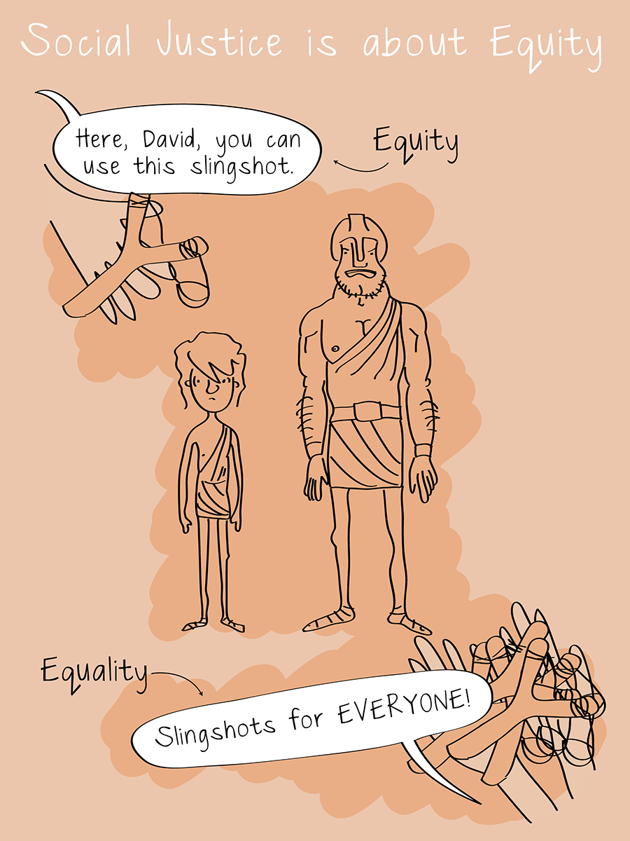
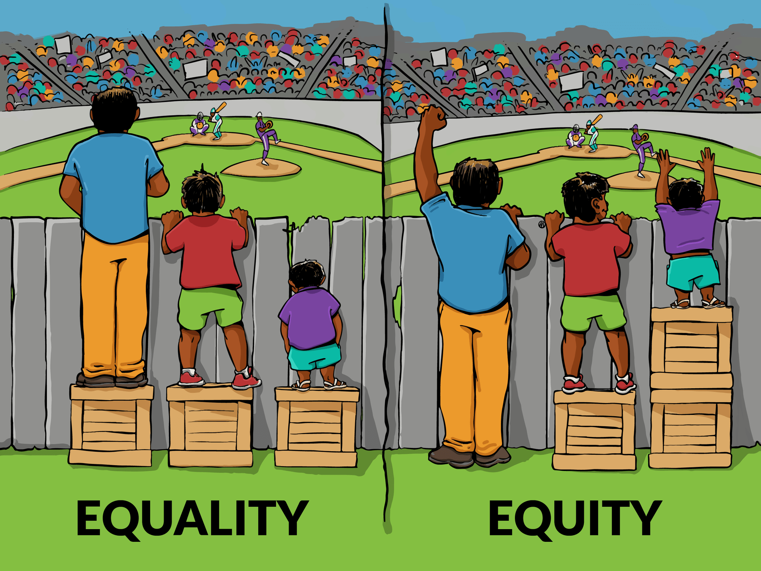
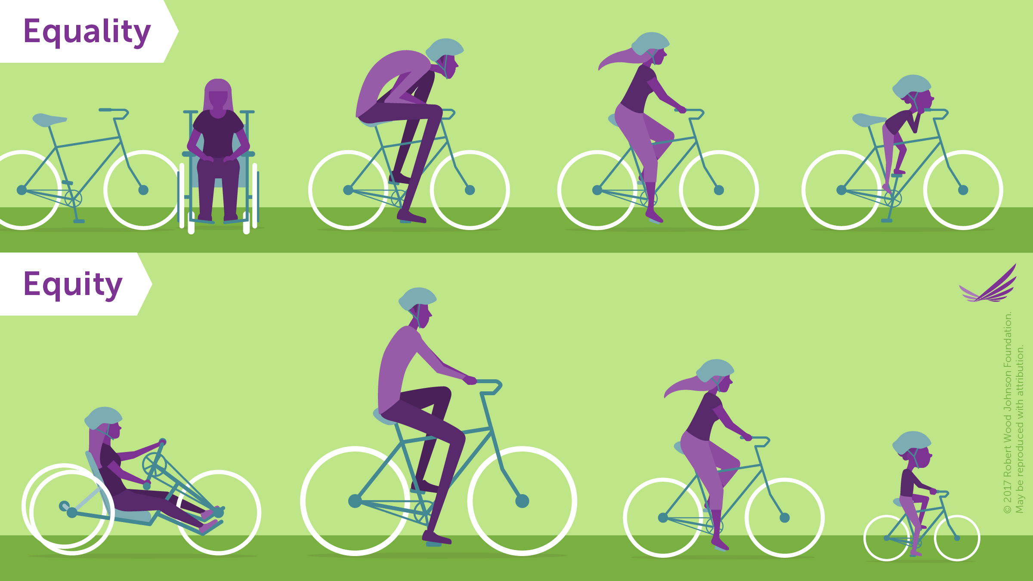
Equity is nuanced
Look at the equity graphics below. What is similar about them? What is different? What do they add to the conversation about equity? What do they leave out?
Visualizing Health Equity: One Size Does Not Fit All, infographic by Robert Wood Johnson Foundation
Interaction Institute for Social Change | Artist: Angus Maguire
“Social Justice is about Equity,” Sam Killerman
Notes:
Note: Equity is a complex concept, and thus, it’s not surprising that attempts to represent it in a simple graphic sometimes lead to disagreements. The far left image, for example, is perhaps the most recognizable equity graphic, but we hesitated to include it in this PowerPoint because it has met with a great deal of criticism that we find persuasive. Check out "The problem with that equity vs. equality graphic you’re using“ (https://culturalorganizing.org/the-problem-with-that-equity-vs-equality-graphic/) by Paul Kuttner if you’d like to learn more. Ultimately, we decided that we would include the graphic because it is so widely recognized, and because it presents a potential learning opportunity with students. If you choose to use the graphic, we encourage you to engage your students in a conversation about the problems that Kuttner’s article describes. You could even assign Kuttner’s article as part of this tool.

Slide 10
What does Equity Mean for an engineer?
Imagine that you are a civil engineer responsible for helping to build large infrastructure projects. What does equity have to do with your job? Consider what PolicyLink has to say:
“Smart, targeted, and equitable public infrastructure investments can generate enormous community benefits—jobs, business opportunities, access to public transportation, and quality affordable housing. When we invest in infrastructure, we must always ask these questions: Who pays? Who benefits? Who bears the environmental impacts? And, who decides? To ensure all people benefit from these public investments, everyone—including and especially residents of low-income communities and communities of color—must have a seat at the negotiating table.”
What do you think? What does it mean to give everyone a seat at the table in engineering projects?

Slide 11
What does Equity Mean for an economist?
In “What is Equity?” economist Stephan Klasen argues that equity = justice and fairness. In order to measure equity, he believes economists need to “start with a clear definition of equity as fairness, [and] why fairness is something intrinsically valuable” (75).
Starting from this foundation, Klasen believes economists can effectively approach a number of economic policies that would address equity, including:
“limitations of asset redistributions, of pro-poor investments in assets, of redistribution via the tax and transfer systems, and of using trade and exchange rate policies for greater equity” (76).
How do you think economists should approach the topic of equity? What do you think about the policies Klasen describes?
Notes:
Source: “What is Equity” by Stephan Klasen, Berlin Workshop Series 2006 ©2006 The International Bank for Reconstruction and Development/The World Bank

Slide 12
What does Equity Mean for a Scientist?
In Towards a More Humane Genetics Education, the researchers at BSCS Science Learning notes:
When biology education causes youth to perceive too much genetic variation between racial groups, it can increase prejudice.
Conversely, the way we teach biology can reduce racial prejudice by helping students understand that there is more genetic variation within racial groups than there is between them.
In sum, the humane genetics research project is beginning to suggest that genetics education can create humane or inhumane outcomes depending on how it addresses human difference. If this hypothesis is correct, then science education might be able to attenuate the spread of racism by offering youth a more humane version of genetics education.
What are the implications of this for you as a student? After you graduate?

Slide 13
What does Equity Mean for AN Industrial Designer?
MIXdesign, a new design consulting firm from architect Joel Sanders, believes that industrial design can and should think equitably. Sanders observes:
“The default user of architecture, which is transmitted in building codes, architectural guidelines, and even in architectural education, is basically a youthful, healthy, able-bodied, cisgender, white citizen.”
This Consultancy Firm Wants to Make Equitable Design the New Normal
Sanders and MIXdesign want to counter this problem. One of their solution has been a project called Stalled!, which redesigns public restrooms as multiuse spaces to provide a “safe, sustainable and inclusive [experience] for everyone regardless of age, gender, race, religion and disability.”
When you imagine industrial design projects, what kinds of users do you imagine? How does that impact your design choices?
Notes:
If you’re interested, consider showing your students this video on MIXdesign’s development of “Stalled” restrooms https://www.youtube.com/watch?v=LPLfvajdWXU
You might also discuss with your students the fact that some have criticized Stalled restrooms for taking away women’s access to a private restroom space, something they have traditionally used for refuge. Sanders responds to this criticism by urging people to think more intersectionally. Ask your students to consider this answer, its possibilities, and its limitations.

Slide 14
What does Equity Mean for Computer scientist?
Here at Georgia Tech, The Constellations Center for Equity in Computing has committed to research and advocacy in computing education. Founding partner Bryan Cox notes:
“The lack of women and ethnic minorities and even rural students in [computing] […] they’re self-selecting out, because there’s not a lot of development at the lower grade levels.”
Lien Diaz adds:
“[there is a] very often unconscious bias or belief about […] how students of color achieve in certain subjects like math or science, and that in itself is a barrier for students to continue to study a course like computer science.”
Thus, equity in computing is not simply a matter of equal access to computing education (something many communities lack); it is a matter of redressing the ongoing dismissal of those communities, and empowering students to believe in their capacity for computing.
What do you think is needed to making computing more equitable?
Notes:
Consider showing students this video from the Center itself, which thoroughly explains its mission.

Slide 15
Wrap-up
How can our discussions today inform our thinking and work in this class throughout the semester?
What questions should we keep in mind from a society/social equity viewpoint?

Slide 16
Find more tools
https://serve-learn-sustain.gatech.edu/teaching-toolkit

