Slide 1
Living Infrastructure
David Ederer, MPH
June 22, 2018

Slide 2
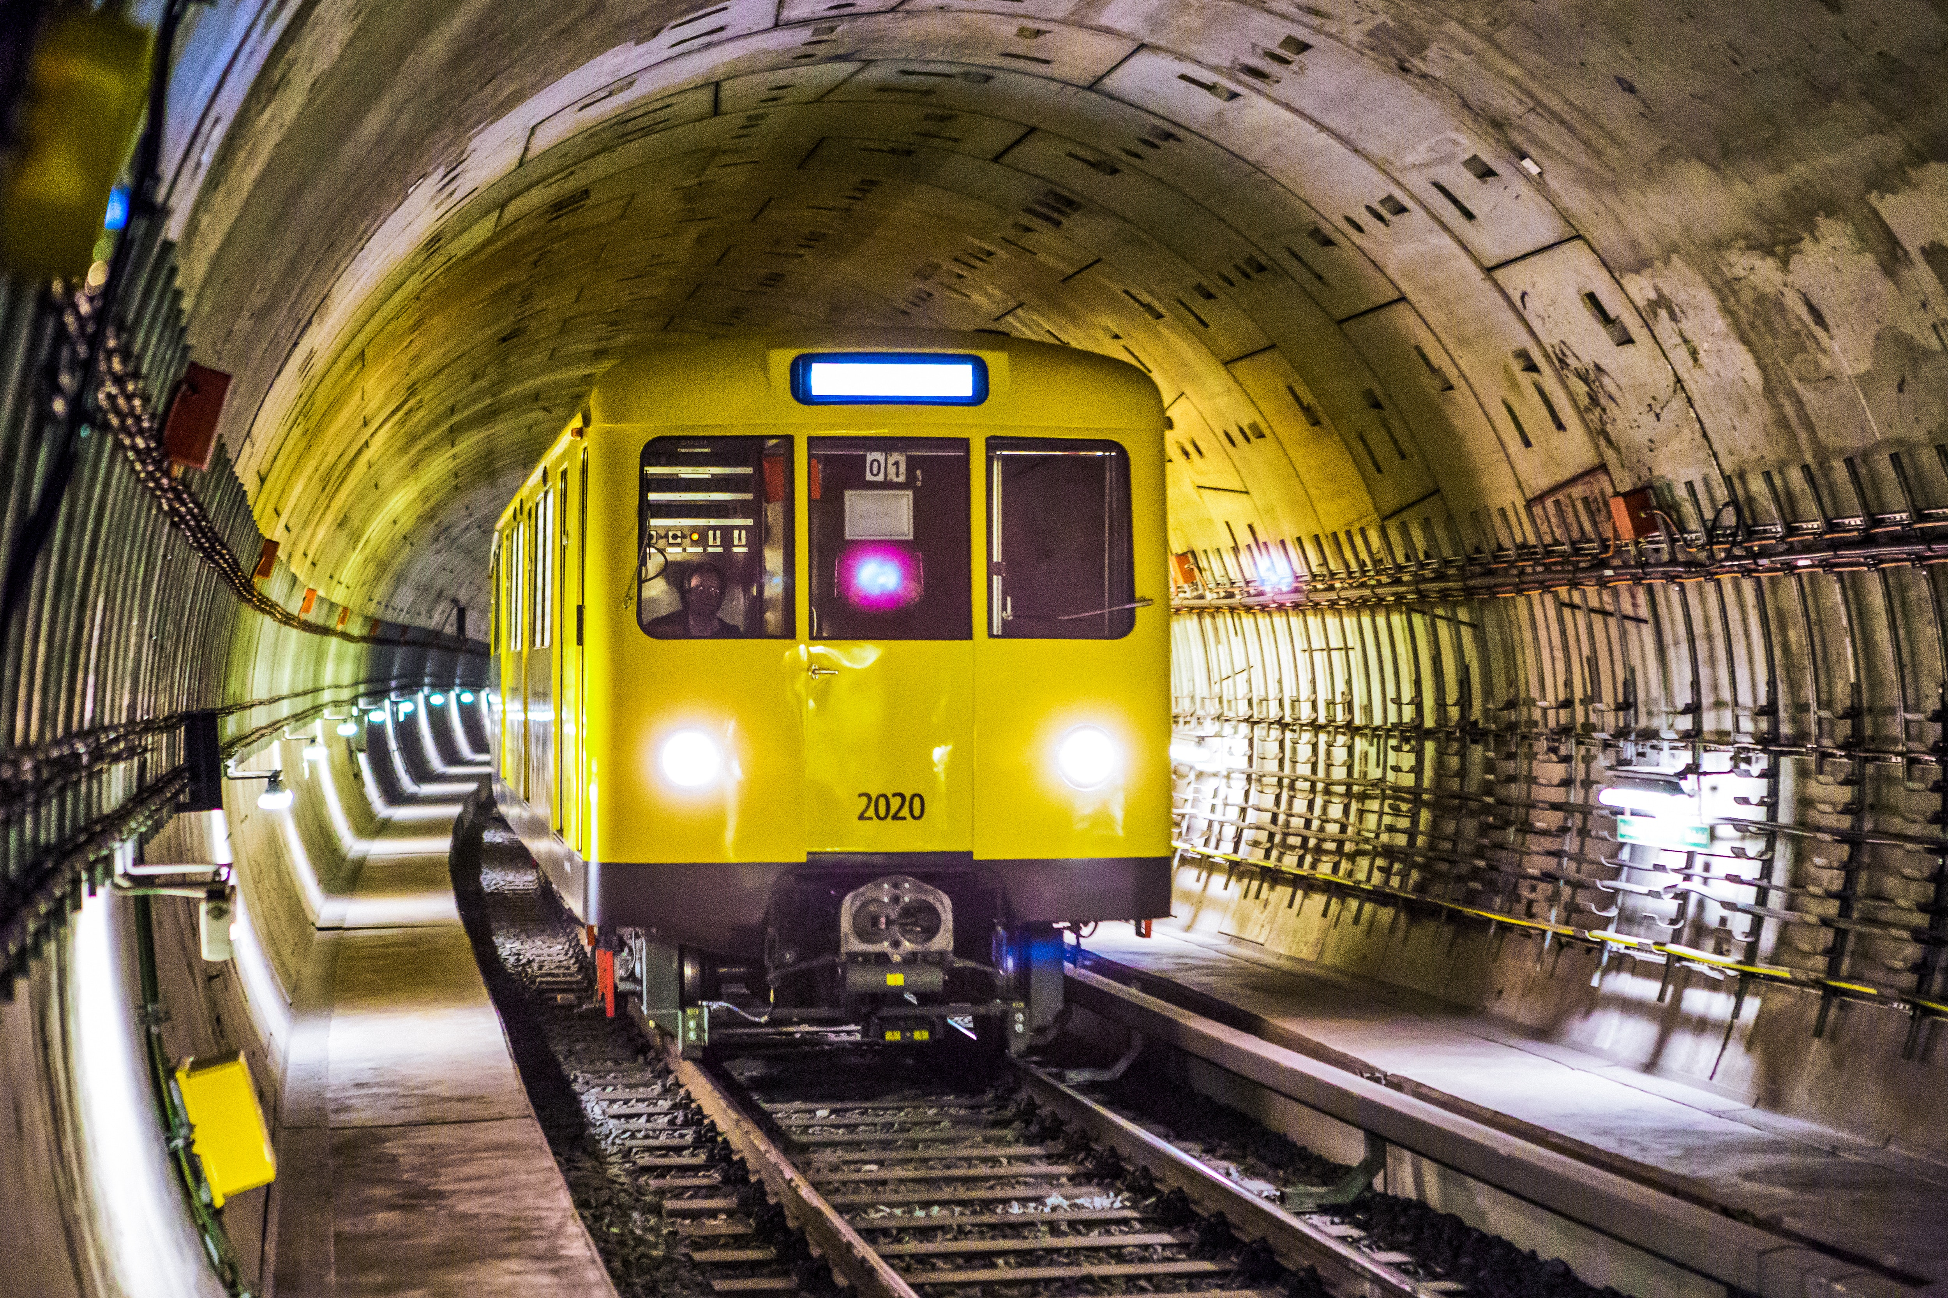
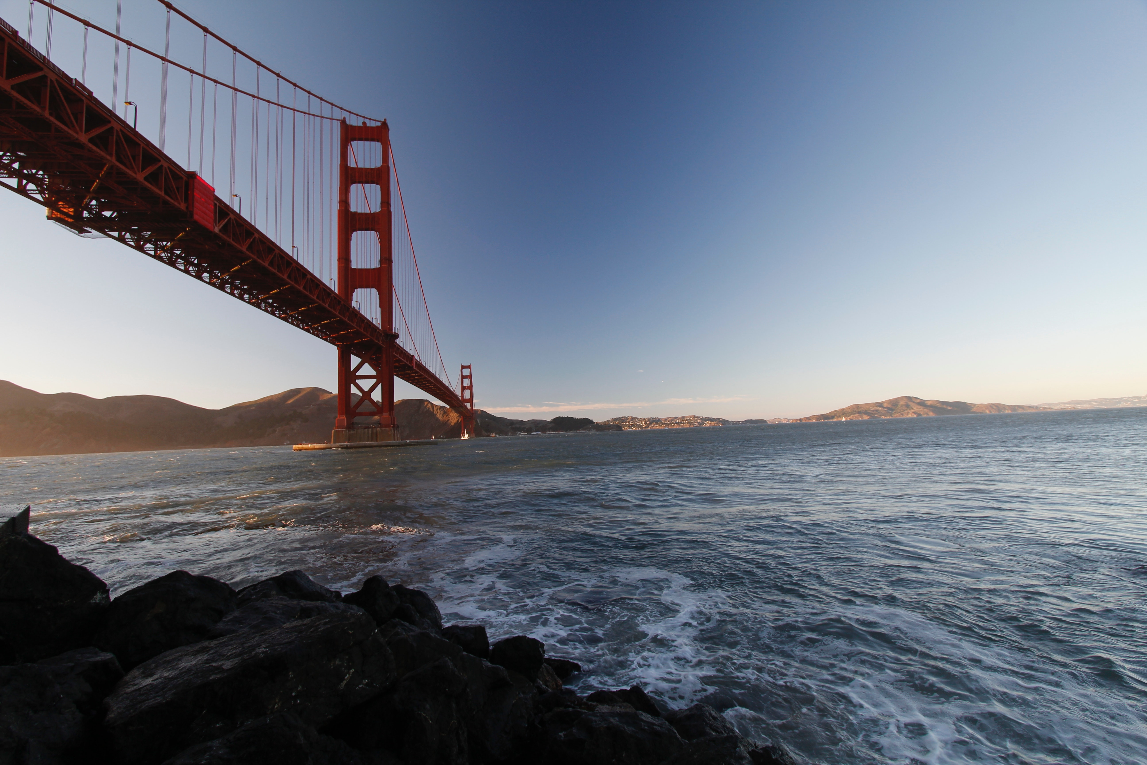
What is infrastructure?
“the physical and organizational structures and facilities needed for the operation of a society or enterprise” (Oxford English Dictionary)
Photos by Anna M. Weber and Juan Salamanca from Pexels
Notes:
According to the Oxford English Dictionary, infrastructure is defined as the “physical and organizational structures and facilities needed for the operation of a society or enterprise.” In other words, infrastructure is that which makes society possible. From pipes, to pavement, to railroad tracks, to cellphone towers, infrastructure helps people communicate, move, trade, and interact. However, we tend to think of infrastructure as a completed, stagnant structure with one specific use. This is rarely the case. Infrastructure can be designed for purposes, or the infrastructure may adapt over time for different things and different people.

Slide 3
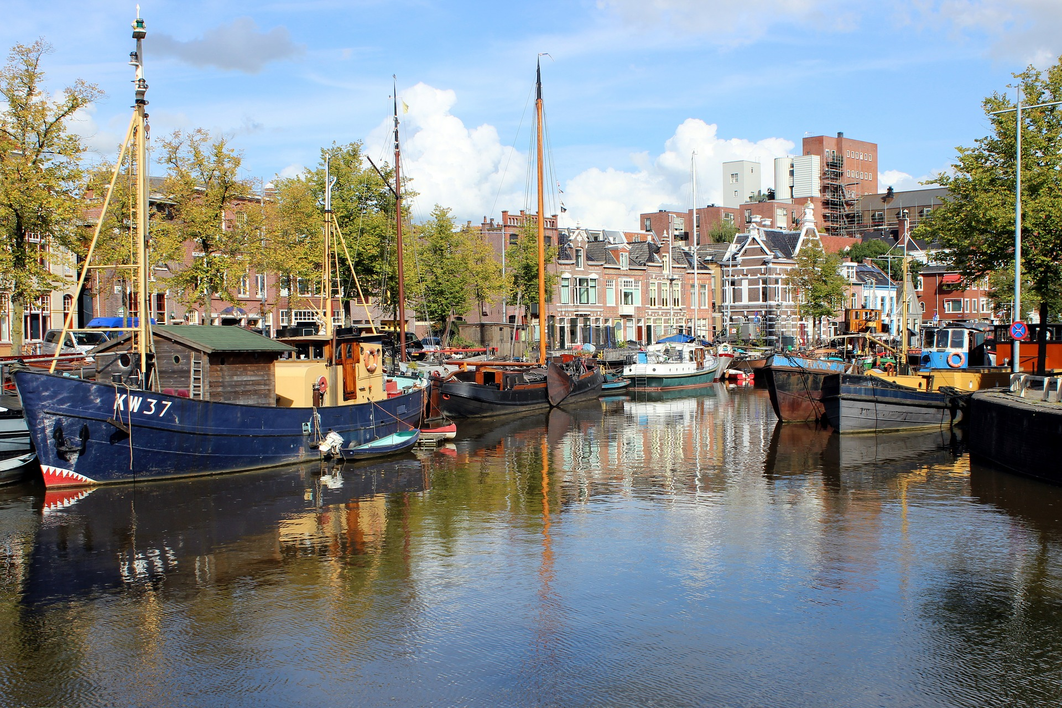
What is infrastructure?
The built environment, and infrastructure especially is deeply tied to identity and culture
The world we build can subtly or not-so-subtly
influence the way people interact
with each other
Infrastructure can be a point of pride,
or division
We should consider how the things we build
have more than one purpose or effect
Notes:
Infrastructure is also deeply tied to identity and culture. The design and layout of one’s street can impact how one interacts (or doesn’t interact!) with neighbors and friends. Highways and railroad tracks have separated communities and people for decades. Canals and watersheds can become part of a city’s story and identity. This is true around the globe. The Golden Gate Bridge is an iconic feature of San Francisco, Atlanta is known for it’s highways, the Dutch for their canals and waterworks, and the Japanese for their high-speed rail. Infrastructure can be a source of pride, community, debate, division, and many other things. This is the result of the fact that infrastructure isn’t experienced by people in the same way.
One person’s highway to get to work, might keep another person from living in a healthy, accessible community.

Slide 4
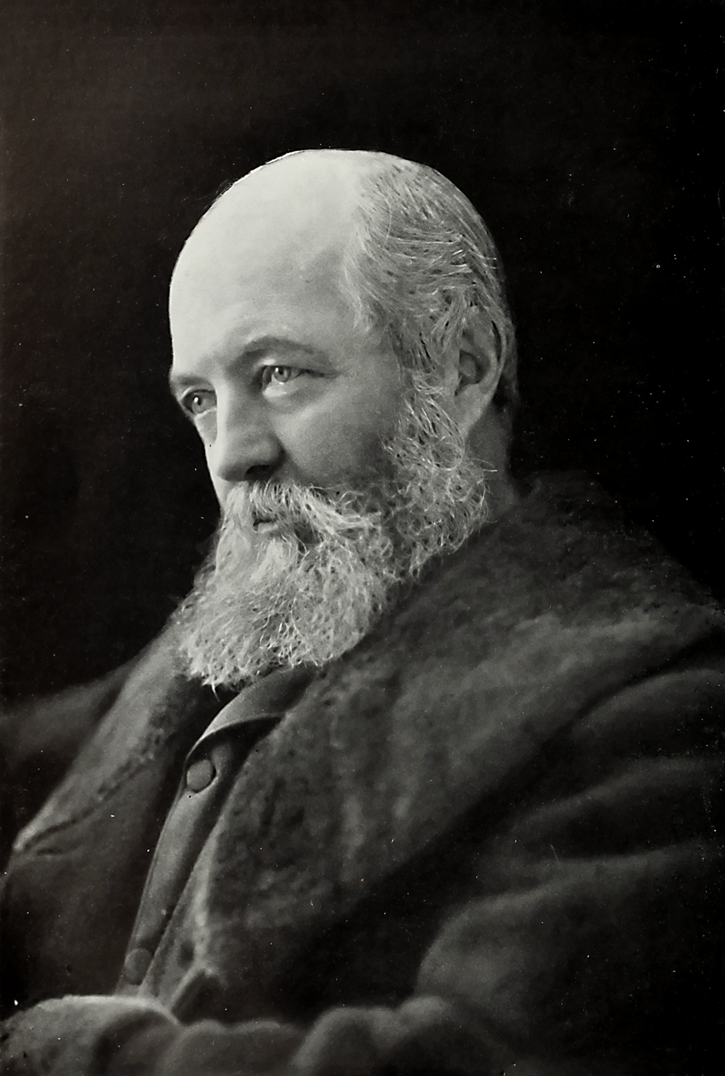
Olmsted and green infrastructure
“A park exercises a very different and much greater influence upon the progress of a city in its general structure than any other ordinary public work, and that after the design for a park has been fully digested, a long series of years must elapse before the ends of the design will begin to be fully realized.”
-Fredrick Law Olmsted
Source: Wikimedia Commons

Slide 5
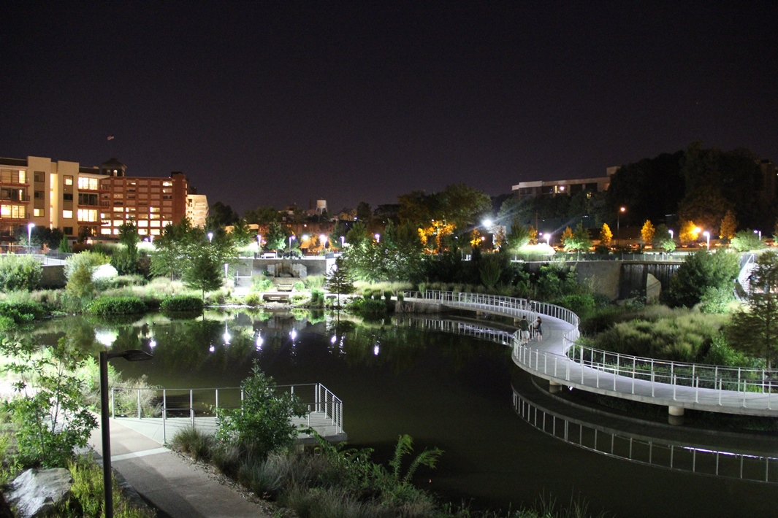
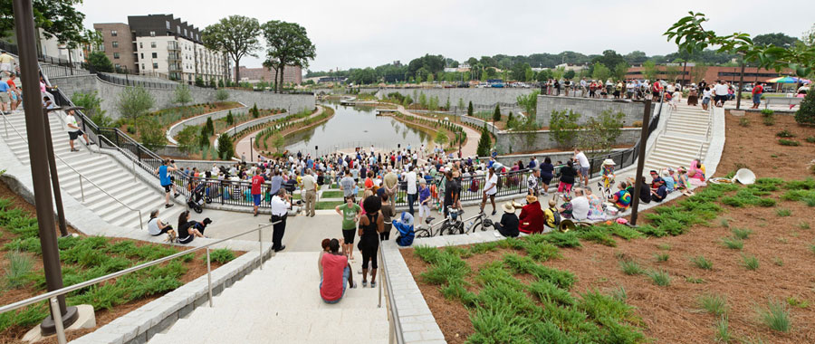
Multiuse infrastructure
Infrastructure need not meet only one purpose
Good design incorporates multiple uses and for many people
For example, a park or greenspace might serve as:
Transportation infrastructure
Stormwater infrastructure
Recreational space

Slide 6
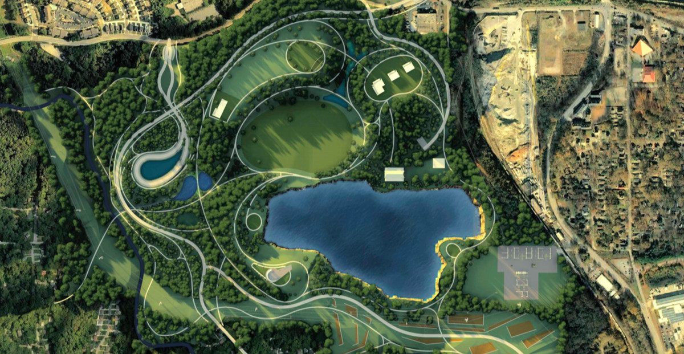
The atlanta beltline and infrastructure
The Atlanta BeltLine began as a transit infrastructure project
It has created space for people to walk and cycle for transportation
But the system of parks has also helped storm and drinking water
Historic Fourth Ward Park mitigates runoff from the Old 4th Ward
When complete, Reservoir Park will increase Atlanta's water supply by 10 times
Photo from: atlanta.curbed.com/2018/1/2/16835628/atlanta-westside-park-bellwood-quarry-revealed
Notes:
The BeltLine is a massive project in both vision and implementation. The BeltLine was originally conceived by Georgia Tech student Ryan Gravel as a network of light rail lines connecting the city of Atlanta. After the initial thesis, community members began organizing as “The Friends of the Atlanta BeltLine.” As the project began to take shape, the vision for the BeltLine expanded beyond the transit line, and includes objectives for parks, multi-use trails, affordable housing, historic preservation, and economic development.
Over time, the purpose of the BeltLine has changed and grown. That has been deeply influenced by community members and policy-makers alike. Community members identified problems they were facing such as flooding and lack of greenspace. The BeltLine has grown to meet those needs.

Slide 7
BeltLine’s Expanding vision
Transit (1999)
Economic Development (1999)
Trail (2001)
Parks (2004)
Affordable Housing (2005)
Public Realm (2006)
Public Art (2006)
Preservation (2006)
Public Health (2007)
Community Stabilization (2011)
Notes:
The Atlanta BeltLine started out with a specific vision as a transit line. The vision quickly expanded to include economic development. In 1999, Atlanta was a very different city. Most of the city was still suffering from a lack of investment. The areas around the BeltLine were long neglected and much of the corridor itself was abandoned. Some areas of the corridor were still active freight corridors. Soon, Gravel's thesis caught the ear of a local Councilperson, Cathy Woolard. Gravel, Woolard, and others began to go out into the community to pitch their ideas. They frequently worked through the Neighborhood Planning Unit (NPU) System, which was created during the Civil Rights era to facilitate community engagement. From here, citizens began to "own" the BeltLine. Another group, the PATH foundation was working to fulfill a similar goal: use abandoned or underused urban land to create multi-use trails for walking and cycling. After a conversation with the leader of that group (which is still active in Atlanta today!), a multi-use trail was incorporated as part of the BeltLine's vision.
In YEAR, the Friends of the Atlanta BeltLine was formed. This was a citizen-led non-profit advocating for the BeltLine.

Slide 8
Atlanta BeltLine Program Elements
Parks
Trails
Transit
Economic Development
Affordable Housing
Project includes 1300 acres of park land and will upgrade 700 acres of existing parks
33 miles of multiuse trails
22 mile BeltLine Corridor
Light rail transit is proposed within the 22 mile corridor
20% of new units built within corridor, or 5,600 units
Streetscape Improvements
Below 60% Area Median Income (AMI) for rentals and below 100% of AMI for ownership
Improve pedestrian and cyclist infrastructure and environment to link to trail
30,000 permanent jobs
48,000 one-year construction jobs
$6 billion in private development
11 miles of spur trails to connect to neighborhoods
Notes:
After years of advocacy and community engagement, the BeltLine found itself as an official quasi-governmental agency in the City of Atlanta. Atlanta BeltLine Inc. was created in 2005. The Friends of the Atlanta BeltLine were subsequently subsumed into a new organization known as the Atlanta BeltLine Partnership, a non-profit run separately from the agency creating the BeltLine.
Atlanta BeltLine Inc. was placed under Invest Atlanta, the city's economic development agency. This is related to how the BeltLine is funded through a Tax Allocation District, which uses monies from property taxes collected in the BeltLine corridor. ABI outlined 6 key program elements based on how the BeltLine developed over time: parks, trails, transit, affordable housing, streetscape improvements, and economic development.

Slide 9
Atlanta BeltLine Progress
Affordable
Housing
Private
Investment
Parks
Trails
Transit
39%
28%
0%
15%
68%

Slide 10
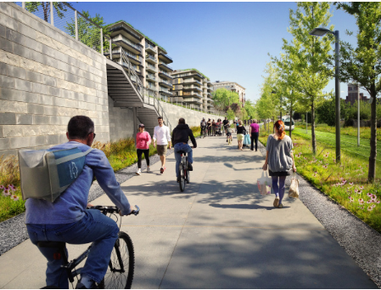
Past, Present, Future
Photo from: ryangravel.com -revealed

