Slide 1
AN INTRODUCTION TO COMMUNITY HEALTH

Slide 2
WHAT IS COMMUNITY HEALTH?
Community health is the state of wellbeing of a group of individuals who share common attitudes, beliefs, interests, histories, and/or goals.
The health of a community is influenced by a variety of factors that are internal to the community itself, including the interactions, contributions, and health of individuals in the community, as well as those factors external to the community over which the community has less control.

Slide 3
KEY CONCEPTS OF COMMUNITY HEALTH
 | KEY CONCEPT
1 | All aspects of life contribute to health and wellbeing.
2 | The relationship between the community and the individual is symbiotic.
3 | Each community has a unique set of assets and inequities, and should be approached accordingly.
4 | Community health should be community-led, with community members serving as co-producers.
5 | Decisions by stakeholders involve tradeoffs.
6 | Communities impact (and are impacted by) events and policies at regional, national, and global levels.

Slide 4
KEY CONCEPTS OF COMMUNITY HEALTH
1 | All aspects of life contribute to health and wellbeing.
2 | The relationship between the community and the individual is symbiotic.
3 | Each community has a unique set of assets and inequities, and should be approached accordingly.
4 | Community health should be community-led, with community members serving as co-producers.
5 | Decisions by stakeholders involve tradeoffs.
6 | Communities impact (and are impacted by) events and policies at regional, national, and global levels.

Slide 5
WHY COMMUNITY HEALTH?
“Human beings are at the center of concerns for sustainable development. They are entitled to a healthy and productive life in harmony with nature.”
-Rio Declaration on Environment and Development ¹

Slide 6
WHY COMMUNITY HEALTH?
“The goals of sustainable development cannot be achieved when there is a high prevalence of debilitating illnesses, and population health cannot be maintained without ecologically sustainable development.”
- The Commission on Sustainable Development ²

Slide 7
WHY COMMUNITY HEALTH?
“Working at the community level promotes healthy living, helps prevent chronic diseases, and brings the greatest health benefits to the greatest number of people in need. It also helps to reduce health gaps caused by differences in race and ethnicity, location, social status, income, and other factors that can affect health.”
- Centers for Disease Control and Prevention ³

Slide 8
WHO IS YOUR COMMUNITY?
Atlanta is one of your communities!
“Over the past thirty years, adequate access to healthy, affordable food has shifted in Atlanta, and some communities that were food secure are now categorized as food deserts.
Why do communities lack access to healthy, affordable food?
And why do the locations of food deserts shift over time?”
- from “Shifting Access to Food: Food Deserts in Atlanta, 1980-2010” ⁴

Slide 9
WHO IS YOUR COMMUNITY?
Georgia Tech is one of your communities!
A group of students at Georgia Tech sought to shed light on Klemis Kitchen’s work on campus
Their research study reported that over 10% of Georgia Tech students (82 out of 788) believe they are in need of food assistance ⁵
Klemis Kitchen operates under the idea that no student at Georgia Tech should go hungry.
Notes:
http://grandchallenges.gatech.edu/sites/default/files/pdf_project/food_insecurity_at_georgia_tech_white_paper.pdf

Slide 10
COMMUNITY HEALTH MODEL EXPLAINED
The foundation of community health rests upon the resources, access, and agency of a community.
Resources are financial resources, medical facilities and social workers.
Access includes things like access to care, access to support, and access to knowledge.
Agency is the awareness and sense of empowerment of individuals and the community as a whole to act.
Resources, access, and agency are enveloped in the concepts of justice and equity to acknowledge that communities are unique with regard to historic and systemic advantages and disadvantages.

Slide 11
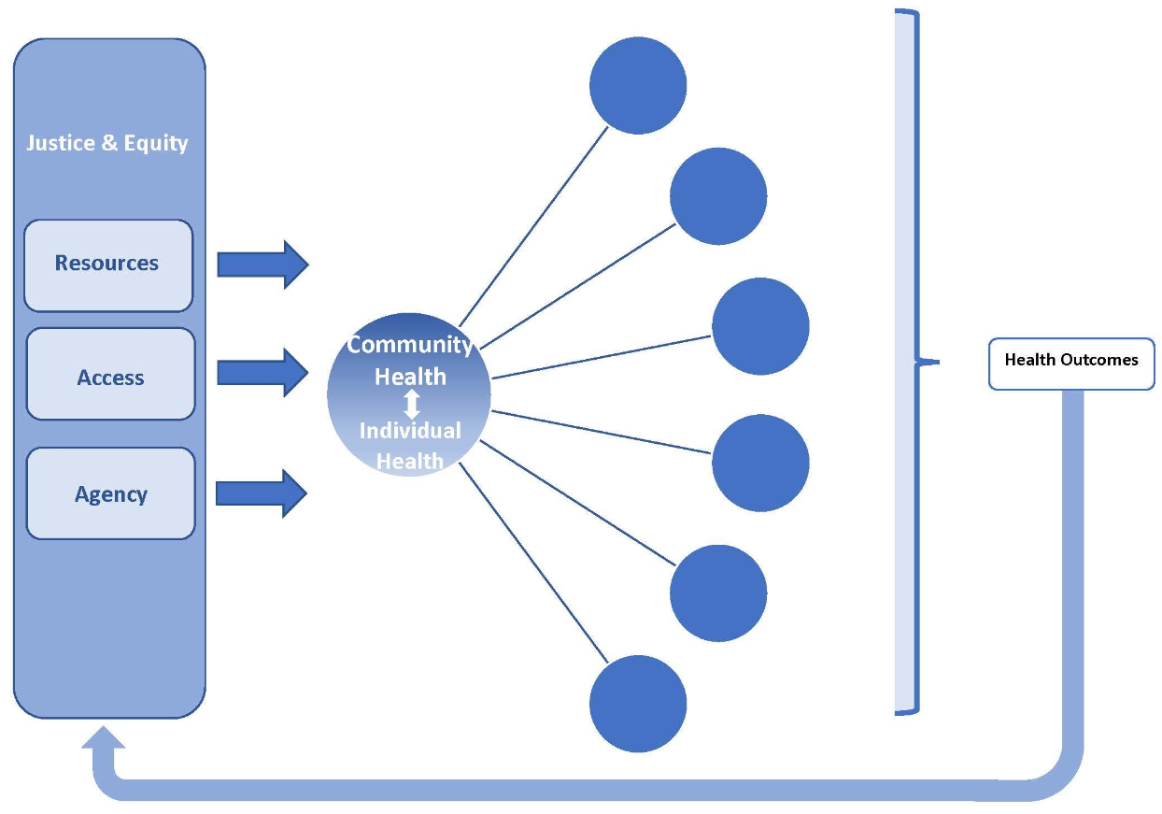
COMMUNITY HEALTH MODEL
?
?
?
?
?
?
Notes:
Slide 12 & 13 explain this model in detail.

Slide 12
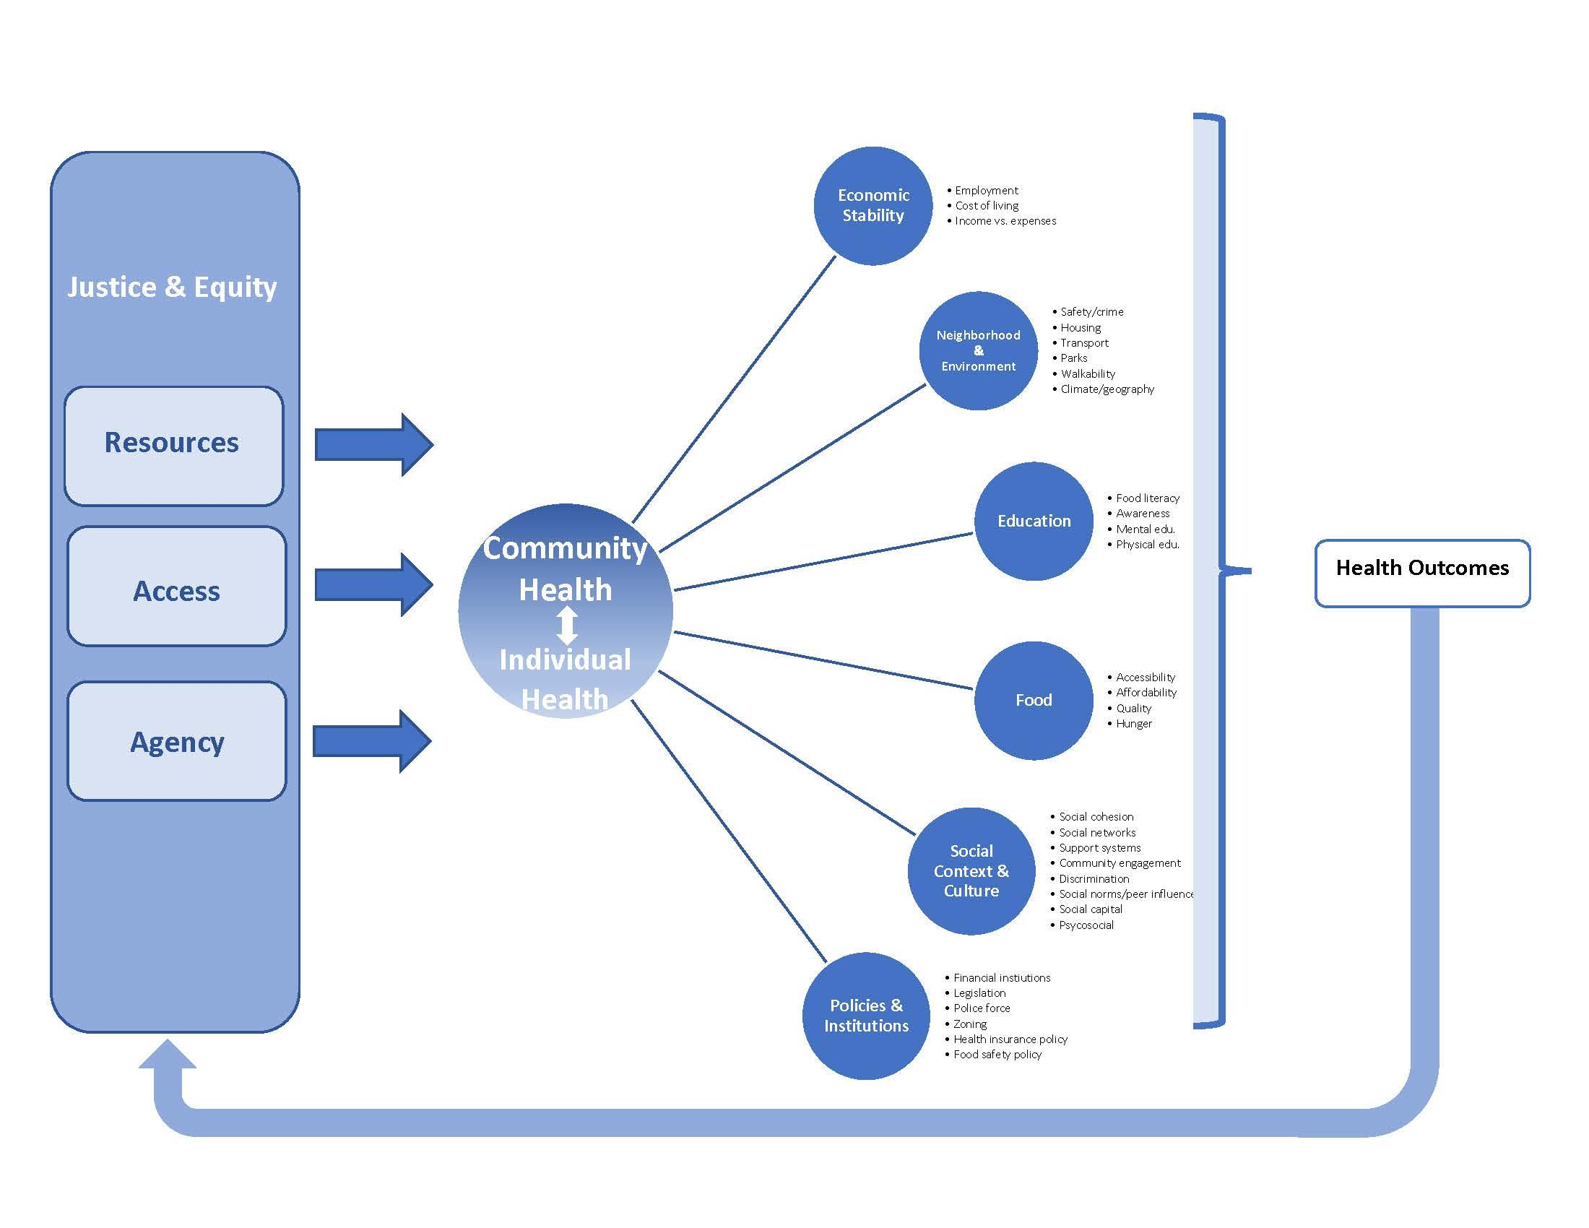
COMMUNITY HEALTH MODEL
Notes:
Slide 12 & 13 explain this model in detail.

Slide 13
COMMUNITY HEALTH MODEL EXPLAINED
A strong and balanced foundation will be one in which the resolve of a community is to ensure that each individual be treated with dignity, fairness, and empathy.
The relationship between the community and the individual is symbiotic. Community health is multidimensional.
The model identifies five (overlapping and interwoven) aspects of community health: (1) economic stability, (2) neighborhood and environment, (3) education, (4) food, (5) social context and culture, and (6) policies and institutions. Each aspect of community health contributes to the health outcomes of the community.

Slide 14
PROCESS MODEL OF COMMUNITY HEALTH
Notes:
Slides 15-16 explain this model in detail.

Slide 15
PROCESS MODEL EXPLAINED
1. Identify Community-Specific Goals
Understand and describe the community.
Use GIS (geographical information systems), public health datasets, previous studies
Develop communication methods to promote interest, and encourage community participation
Conduct public forums, listening sessions, surveys, interviews, asset mapping, and other CBPR (Community-Based Participatory Research)
Identify facilitators and barriers
2. Identify Resources Internal & External to the Community
i. Internal support
Recruit and organize leaders and volunteers from the community
Individuals – “head, hands, heart”
Local health department/clinics
Professional organizations
Local businesses
Global-local connections
Survivorship support groups
ii. External support
Federal/state initiatives
Grants/funding
Federal programs available
Foundations

Slide 16
PROCESS MODEL EXPLAINED
3. Brainstorm, Evaluate, and Choose Solution
Analyze community goals to design, choose, and adapt interventions for different cultures and communities
Consider sustainability, empowerment, and efficacy
Consider broad-based cost-benefit analysis
4. Implement Intervention
Empower the community through education and skill enhancement
Improve support, incentives, and resources
Increase access and opportunities
Remove barriers
Change policy
Change the physical and social environment
Use community building events
Develop proper methods of media and communication to advocate intervention
5. Evaluate, Monitor & Maintain
Gather and use community-level indicators, surveys, interviews, and other feedback
Routinely reevaluate implementation
Create a formal public reporting process

Slide 17
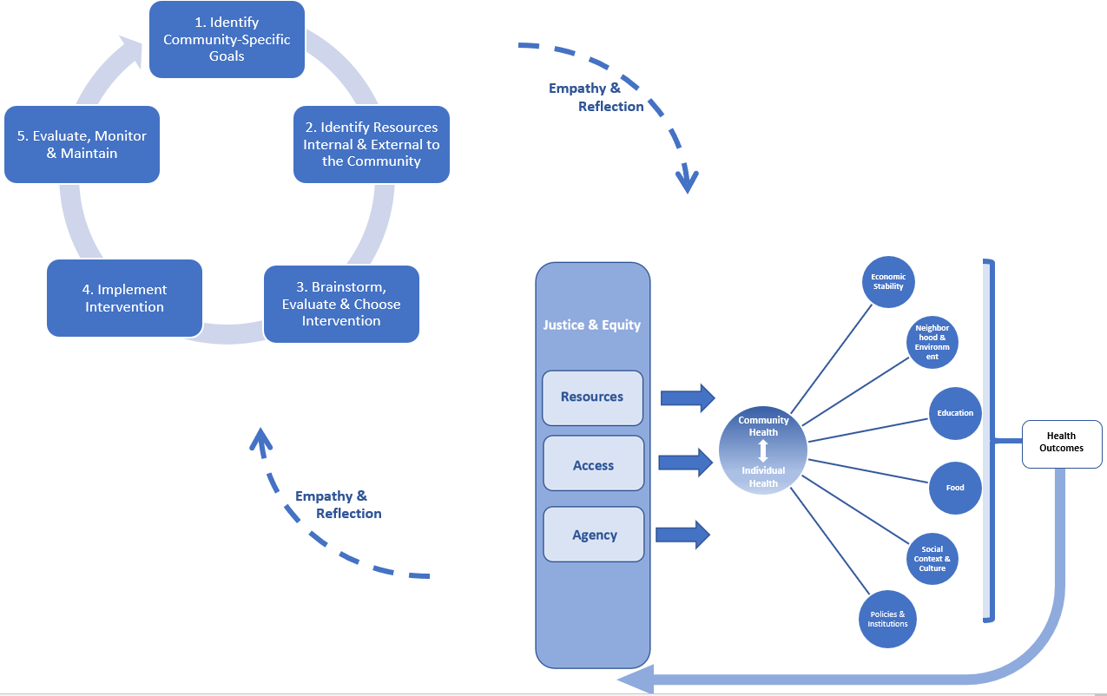
THE LINK BETWEEN THE COMMUNITY HEALTH MODEL AND THE PROCESS MODEL
The Community Health Model should be referenced throughout the methodical process of understanding, analyzing, and evaluating a community for the purpose of community health improvement.
Reflection and empathy are key elements of this iterative methodological process and the related feedback loops.

Slide 18
REFERENCES
Rio Declaration. "Rio declaration on environment and development." (1992).
Von Schirnding, Yasmin ER, Catherine Mulholland, and World Health Organization. Health and sustainable development: key health trends. No. WHO/HDE/HID/02.2. Geneva: World Health Organization, 2002.
Centers for Disease Control and Prevention. "Nccdphp: Community Health." https://www.cdc.gov/nccdphp/dch/about/index.htm.
Hossfeld, Leslie H., E. Brooke Kelly, and Julia Ferrara Waity, eds. Food and Poverty: Food Insecurity and Food Sovereignty Among America's Poor. Vanderbilt University Press, 2018.
Viswanathan, Parth, Suraj Sehgal, Jiali Zhao, and Tanvi Suresh. "Helping Our Own: Addressing Food Insecurity at the Georgia Institute of Technology - Providing Every Student the Opportunity to Succeed." In Grand Challenges, 16. Georgia Tech, 2017.

